Slide 1
Module 2
Introduction to a web-app

Slide 2
Contents
Objective:
Get familiar with the basic terminology of webapps and development
Convert basic understanding into more technical understanding
Topics:
Using a web app
Webapps - A detailed look

Slide 3
Using a webapp

Slide 4
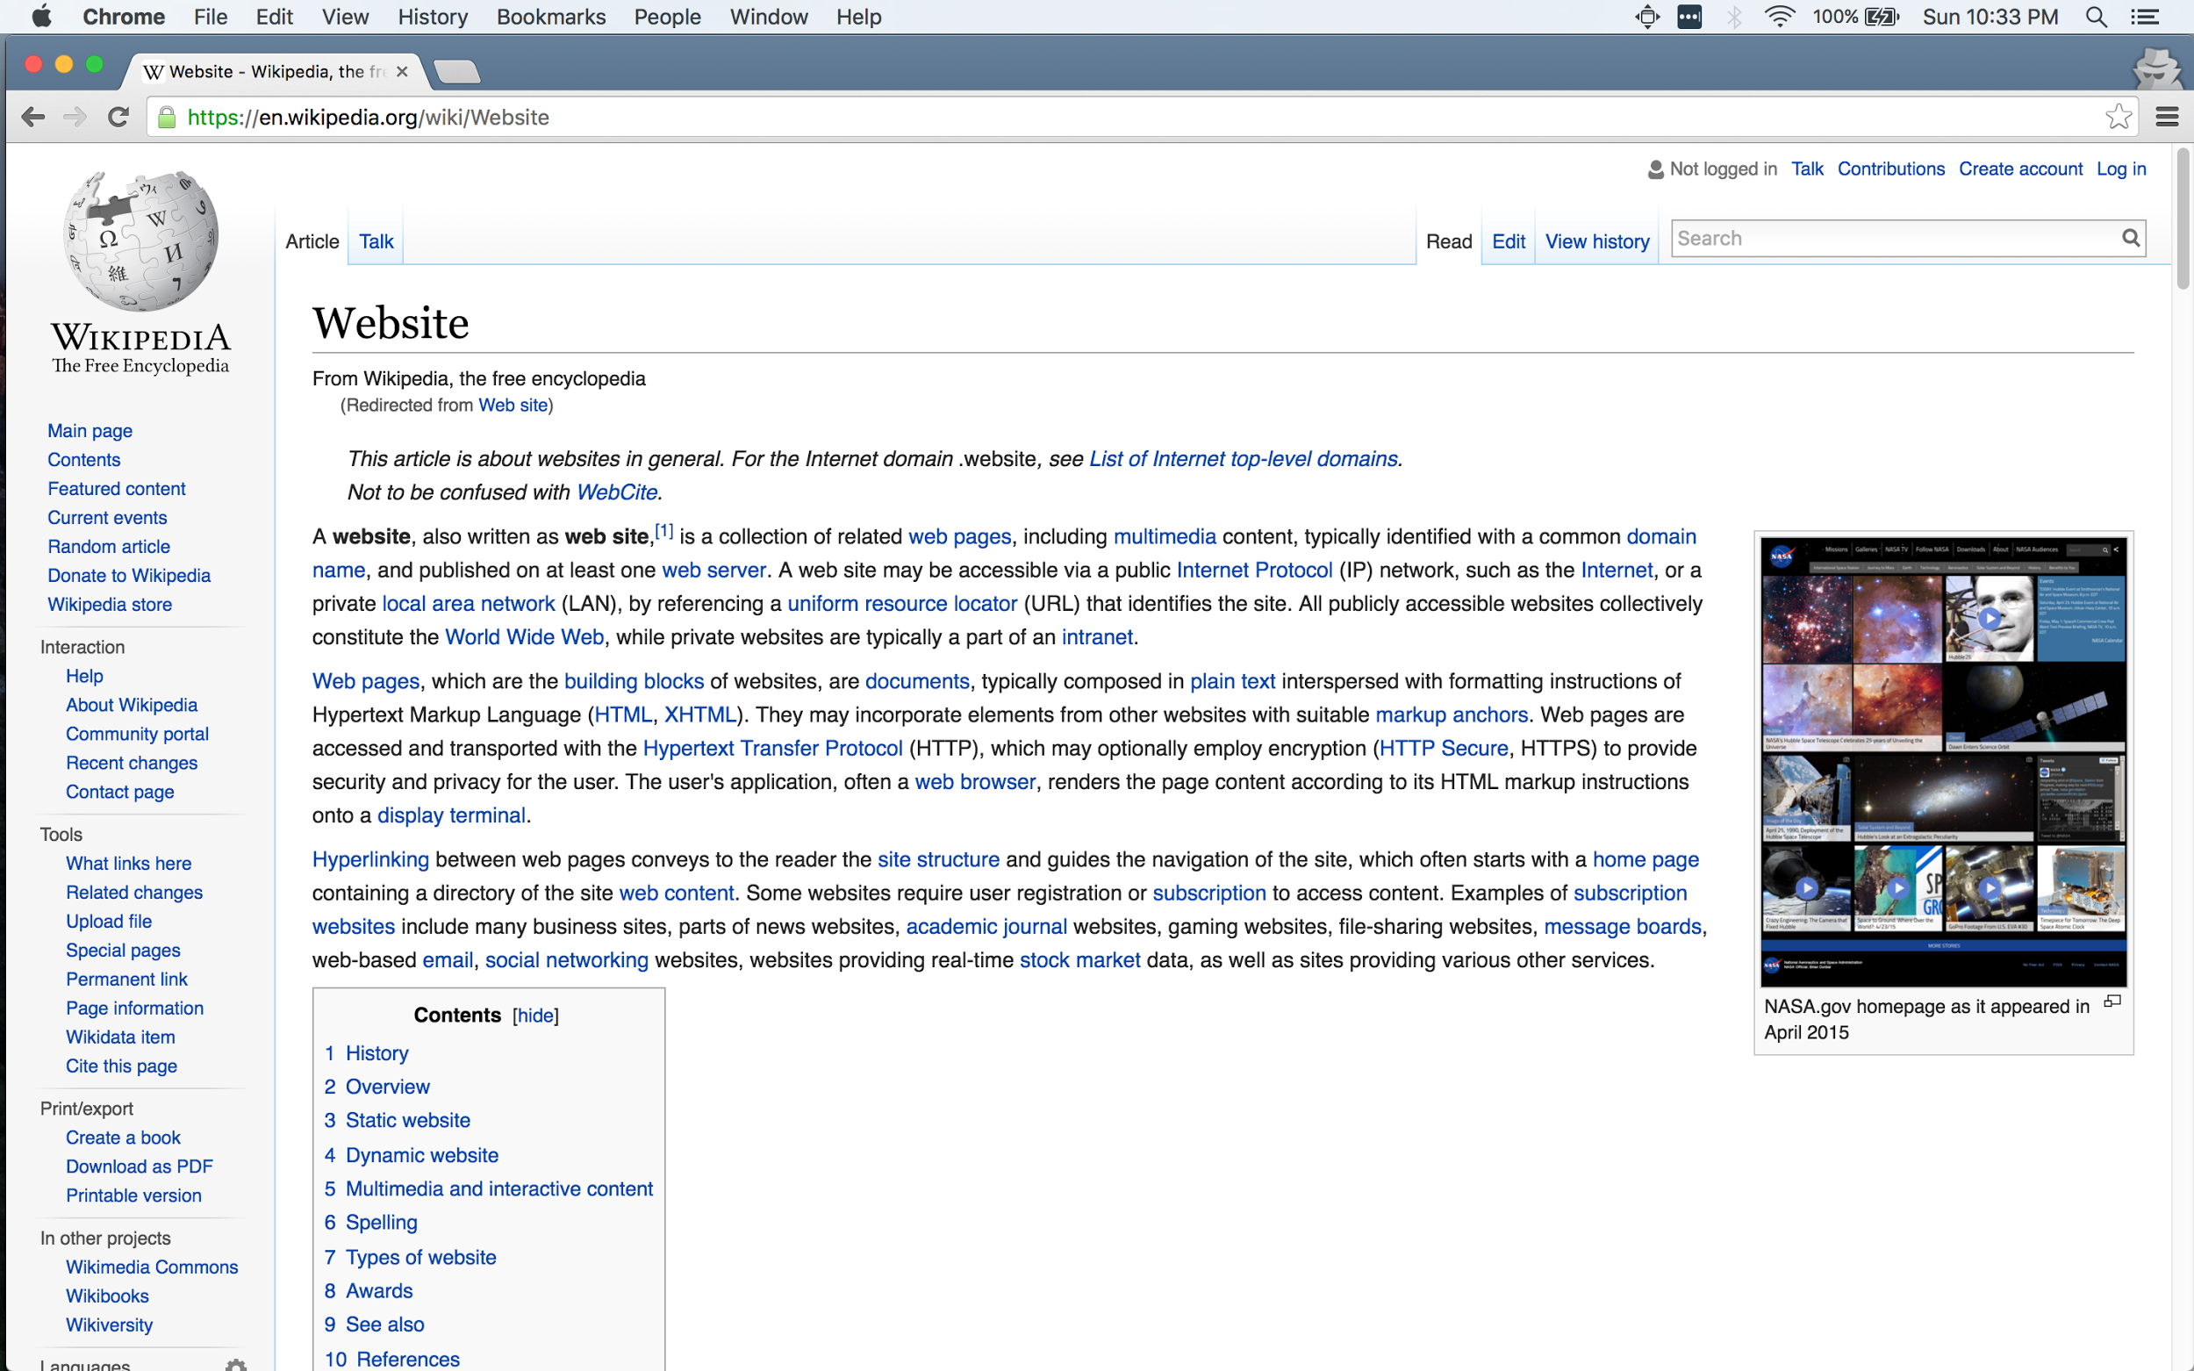
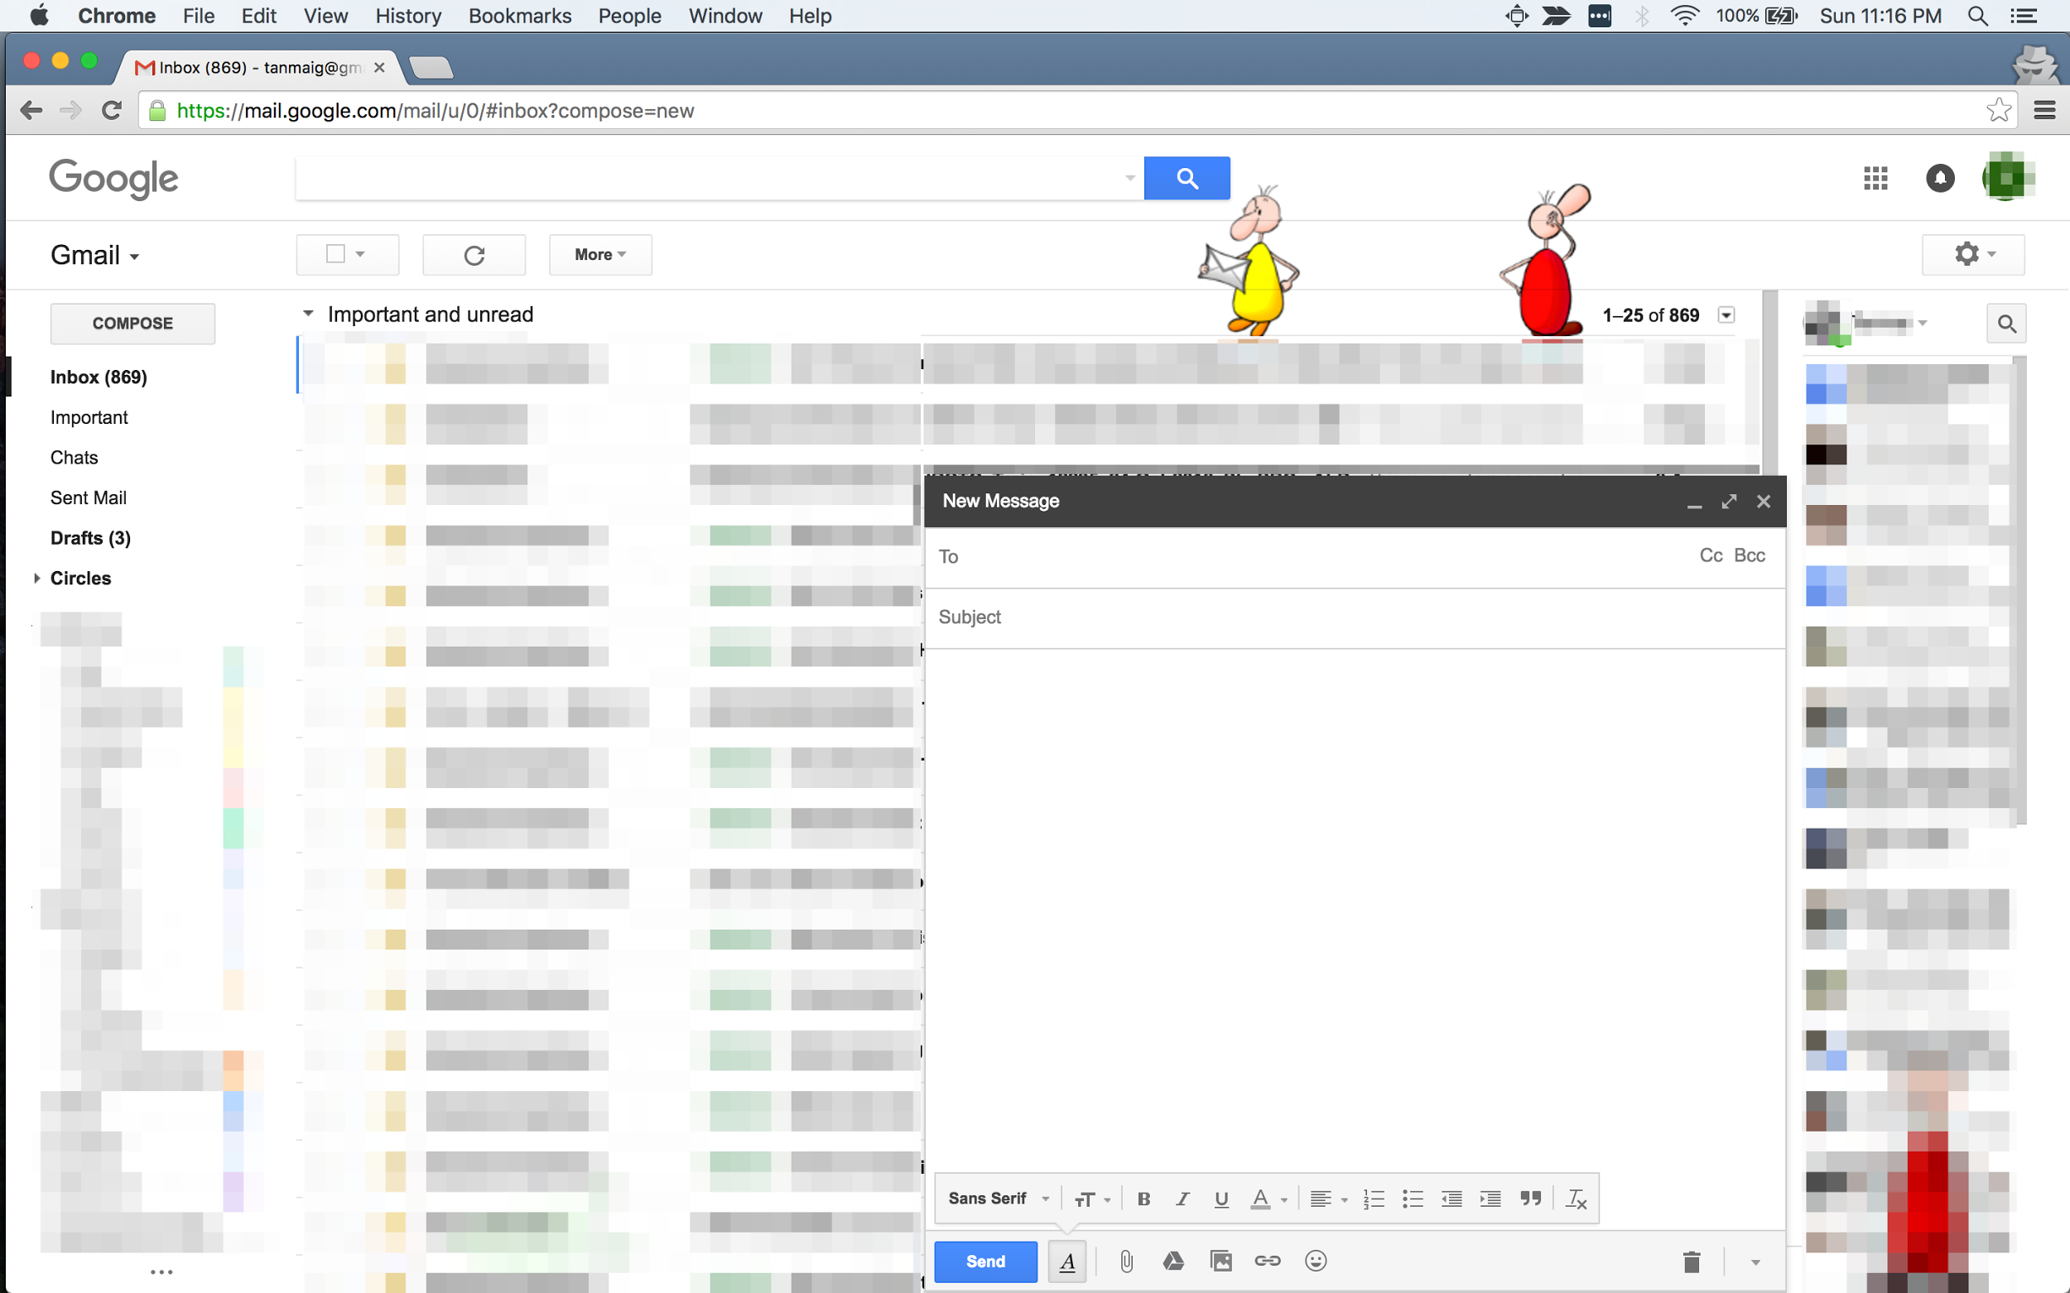
What is a webapp?
A web app is a client-server application that runs in a web browser.
Wikipedia
Gmail
For the rest of this course: webapps ≈ web applications + websites + webpages

Slide 5
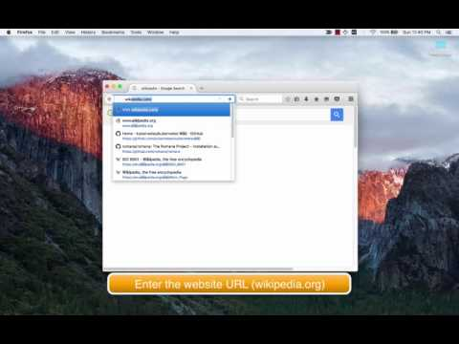
Using a webapp - browsing

Slide 6

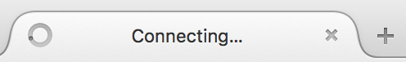
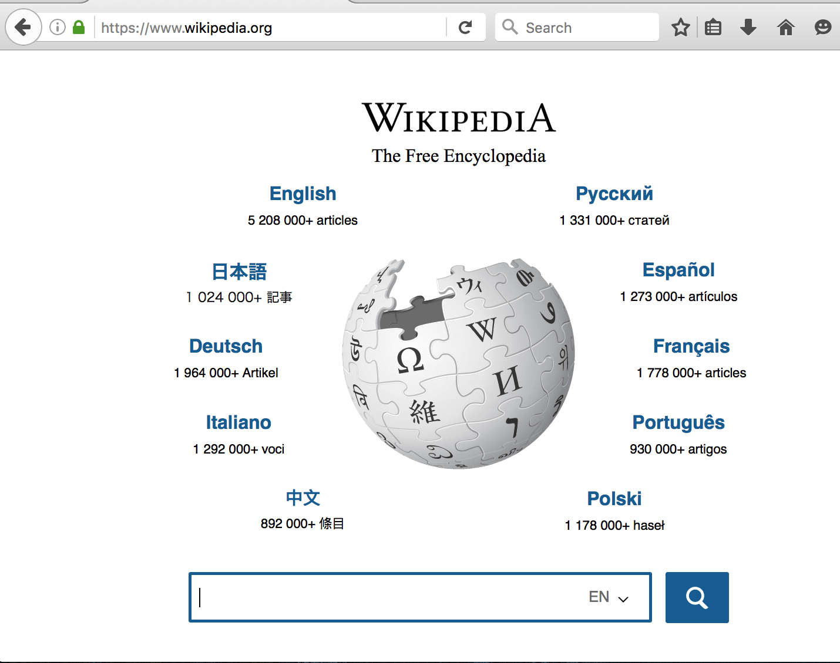
Using a webapp - The Steps
1 | Open a browser application | Firefox
2 | Enter the web address | www.wikipedia.org
3 | The browser fetches the data from the server
4 | The browser displays the webpage

Slide 7
2. Webapps - a detailed look

Slide 8
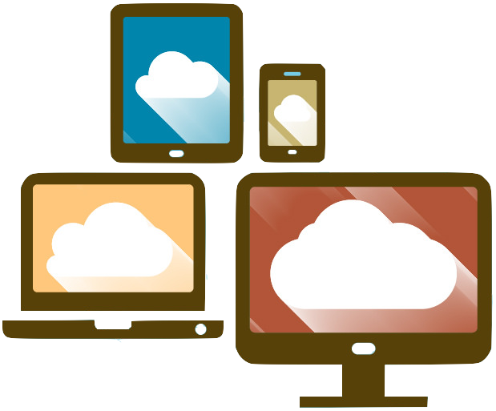


2.1 Browser - Web Client
A browser is a software which needs to be installed on a device to use webapps.
Common browsers
Notes:
Image resource: https://www.flickr.com/photos/111692634@N04/15855652750
https://pixabay.com/en/photos/web%20browsers/

Slide 9
2.1 Browser
Browsers can make requests to servers using URLs and render the response data
Content Type | File extension | Example
text/plain | .txt | http://www.flipkart.com/robots.txt
text/html | .html | http://www.cenlib.iitm.ac.in/docs/library/ejnls-iitm.html
image/png | .png | https://hasura.io/img/hasura-sand.png
application/pdf | .pdf | https://www.iitm.ac.in/sites/default/files/uploads/calendar-revised-jul-nov_2016.pdf
Computer programs that can make requests to servers and fetch responses are called clients. When these programs make requests to web servers, they are called web clients. A browser is a web client.

Slide 10
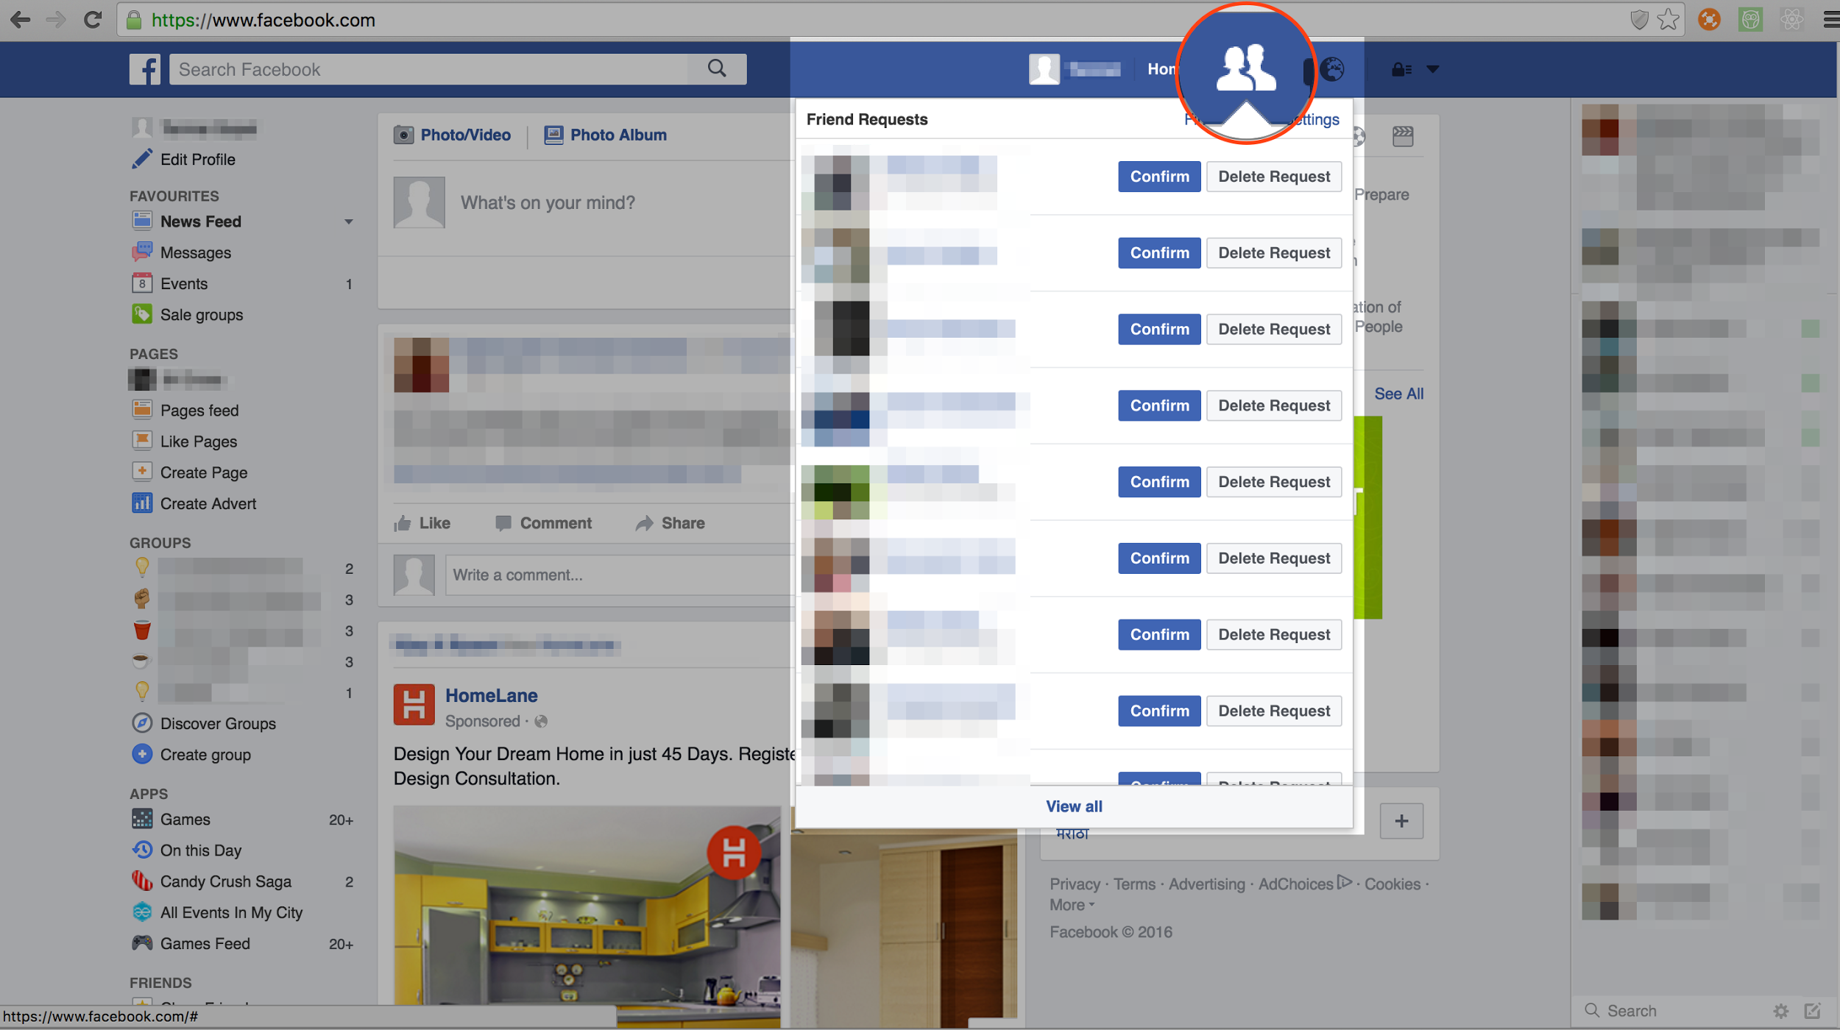
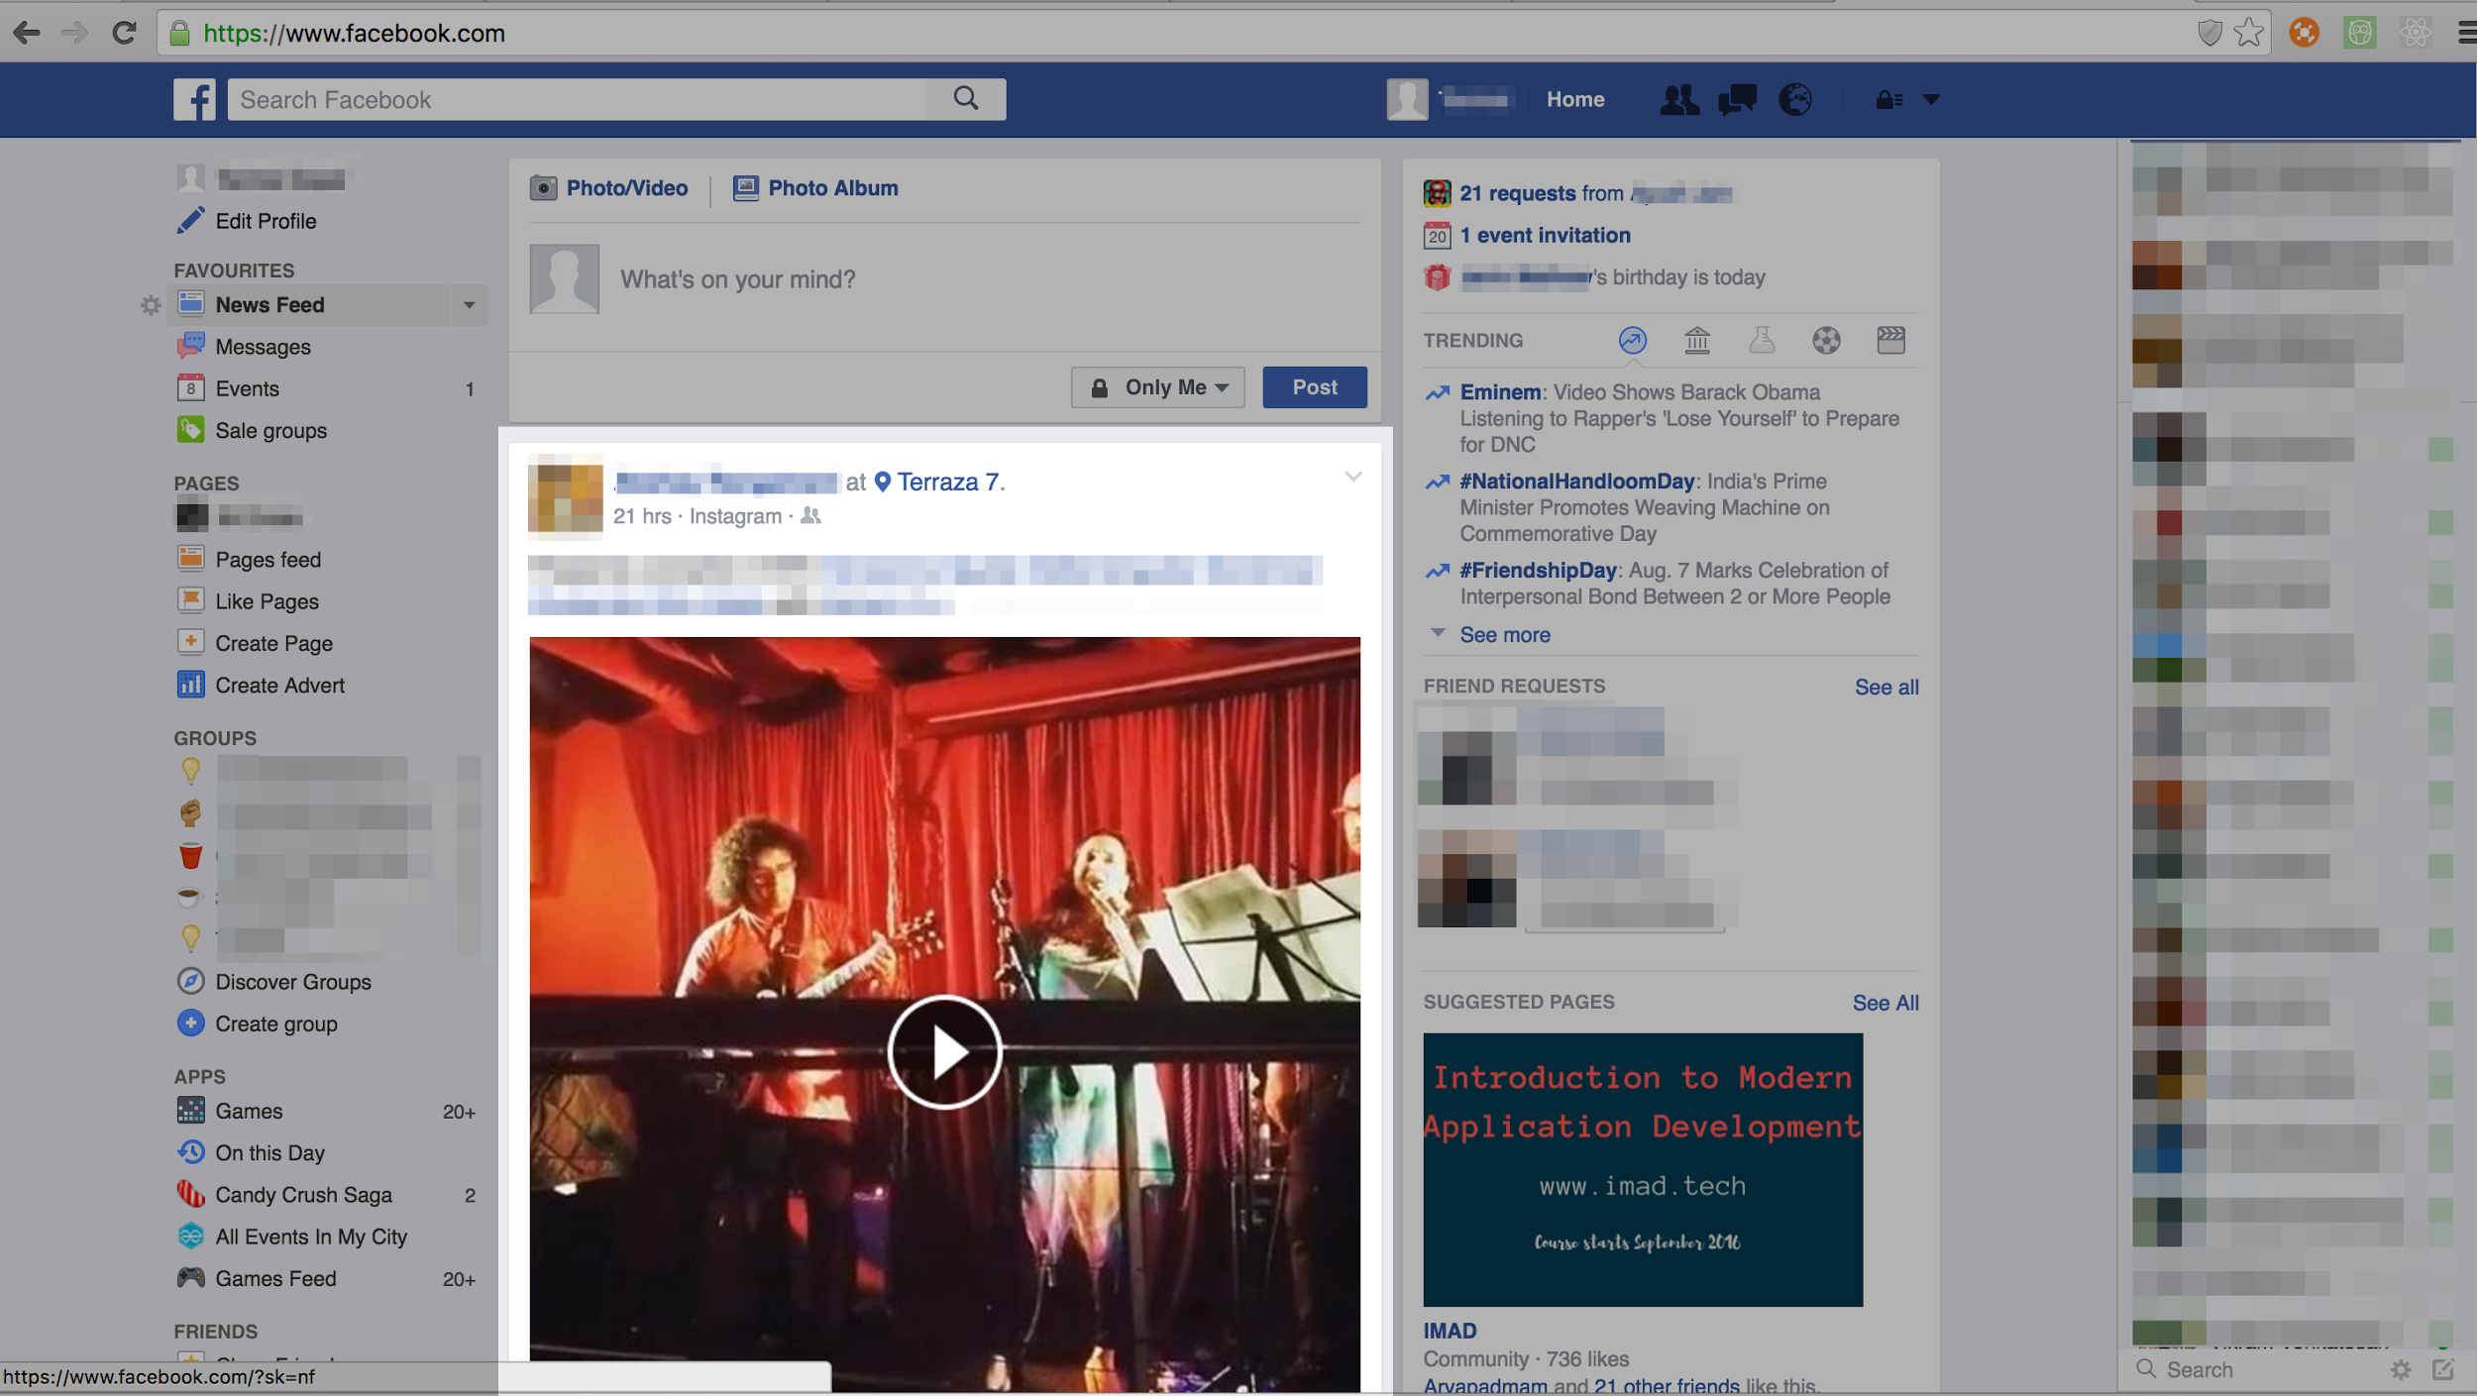
2.1 Browser
Modern browsers can interpret and run code written by the application author (Javascript)
Purpose: Make page interactive or dynamic.
Clicking on the icon shows the pending friend requests (facebook)
Facebook newsfeed keeps automatically fetching new content

Slide 11
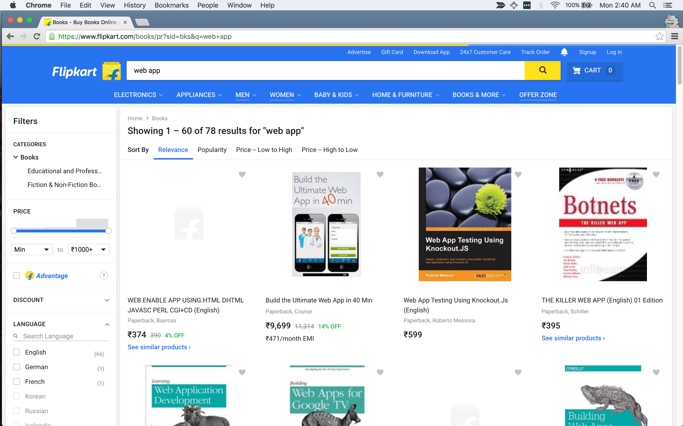
2.2 URL
A URL identifies both the server and the resource (webpage or content)
URL stands for: Uniform Resource Locator
Also informally called ‘web address’
Purpose: Find a resource on the Internet
https://www.flipkart.com/books/pr?sid=bks&q=web+app

Slide 12
2.2 URL
https://www.flipkart.com/books/pr?sid=bks&q=web+app
Protocol
Hostname
Path
Query string
Protocol: It defines the mode/rules of communication between the client and server for the request.
Hostname: It identifies the server which will serve the request. It may contain the domain name. In this case “flipkart.com”
Path: It defines the resource which is being requested. It typically points to a webpage. (in this case list of books)
Query String: It typically contains any additional parameters that is typically used to add more context to the same path (in this case books that are about “web app”)

Slide 13
2.3 DNS - Domain Name System
DNS is like a directory which links the domain name to the IP address of the server
google.com <> 216.58.197.78
facebook.com <> 173.252.89.132
Every server must have a unique IP address which clients can use to connect with it over the internet.
This IP address is mapped to a human friendly domain name to make it easy to remember.
The directory is maintained by “name servers”. Programs can exchange the domain-name for the registered IP address by requesting the name server. This is called a “DNS lookup”

Slide 14
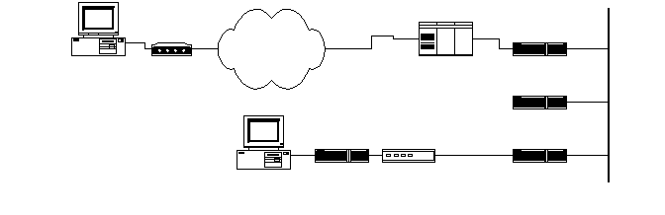
2.4 Network
Your computer connected to your router connected to your ISP, connected to other ISPs, finally connected to another computer (the server)
A program can send a request on a network by mentioning the IP of the other computer and the network (meaning the entire systems of hardware and software) will route your request to the computer that has that IP.
Router
ISP connection
Computer/device
1.2.3.4
ISP
Core router
Server (computer)
5.6.7.8

Slide 15
2.5 Server - Web Server
A web server can listen to requests and respond back with data on the same connection
Web server
Network
Browser
(web client)
response
Computer (host)
request
Very commonly, a server is also used to refer to the actual computer (also called a host) on which the “server” software is installed.

Slide 16
Summary

Slide 17
What we covered
Using webapps
We examined how we use typical webapps
Webapps - A detailed look
We examined the technical components that come together when a webapp works
Web apps & websites
Browser, URL, DNS, Network, Web server
Client - server architecturehttps
You can watch the module video on Youtube:https://www.youtube.com/watch?v=n5CQK1knRko

